Slide 1
Project 3 Chain Reaction

Slide 2
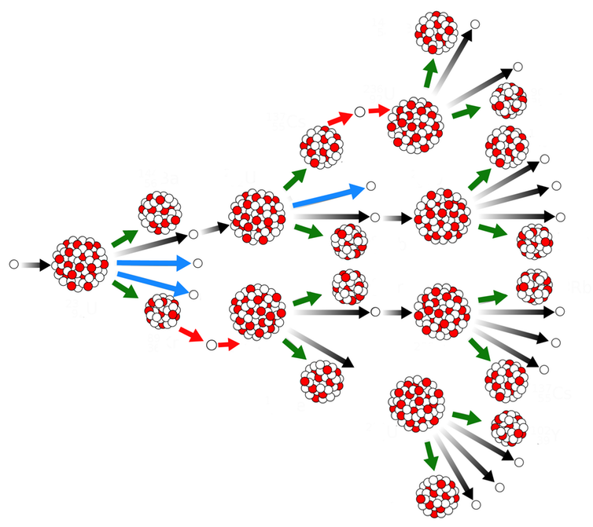
Background
The nuclear explodes and emit a neutron to another nuclear.
The second nuclear explodes and emit a neutron repeated.

Slide 3
Chess Rule
Critical mass: The condition for nuclear explosion.
Critical mass is determined by the orthogonally and diagonally adjacent cells.
3 | 5 | 3
5 | 8 | 5
3 | 5 | 3

Slide 4
Place orb
Two players take turn to add orb on board.
Orb can be added on empty board or the board added by yourself, don’t add the orb on the board added by opponent.
If the orbs on board reach the critical mass, and then explodes.

Slide 5
Explosion

Slide 6
Explosion
If the emitting board has been added by opponent, the chess turns to yours.

Slide 7
Explosion
After emitting, if the board reaches the critical mass and explodes again.
Game over if all of the board exists on color chess.

Slide 8
Compile
OS: Ubuntu 16.04.
g++ chain_reaction.cpp board.cpp rules.cpp player.cpp algorithm_ST.cpp algorithm_TA.cpp
The rules and board setting are written in "rules.cpp" and "board.cpp." Please read the code in those two files before coding.

Slide 9
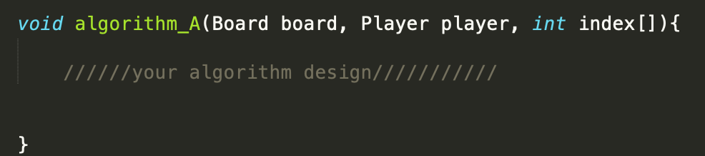
Compile
Please name your code as algorithm_ST.cpp, and do not edit other .cpp files provided. In algorithm_ST.cpp, don’t change function name and parameter.
The main data flow is in the chain_reaction.cpp.
In algorithm_TA.cpp, a "randomMove" code is provided to play as an opponent to help you develop your program. You should not hand in your algorithm_ST.cpp code copied from algorithm_TA.cpp.

Slide 10

Competition
The winner is the one who first collects 4 wins. For the competition with TA, you will be the starting player.
Bonus competition credit will be awarded to every participating student according to the following formula:
$$bonus credit=25\%∗W$$

